Slide 1
ESTE KIT CONTIENE:
400 U | BUCKET, plastic, 14L with clip cover and 50mm outlet
400 U | JERRYCAN, collapsible, 10L, food grade LDPE, screw cap
400 U | JERRYCAN, collapsible, 10L, food grade LDPE, screw cap as a Water Dispensing Bag
400 U | SOAP, body soap, 100g, piece
2 U | PLASTIC SHEETING, woven, 4x60m, white/white, roll
1 U | HYGIENE PROMOTION BOX A, promotion items
4 boxes of 16.000 units | CHLORINE,40mg (NaDCC 67mg),for 10L water,1 tablet,DGR if>5KG
209 boxes of 240 sachets | WATER PURIFICATION AGENT, for 10L –
2 U | POOL TESTER + accessories
500 U | (pool test) TABLET DPD1 for dosing free chlorine
500 U | (pool test) TABLET DPD3 for dosing total chlorine
20 U | SQUATTING PLATES, polypropylene, 100cm x 65cm x 100cm
IFRC
Watsan Kit 2

Slide 2
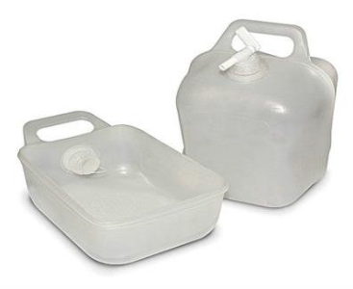
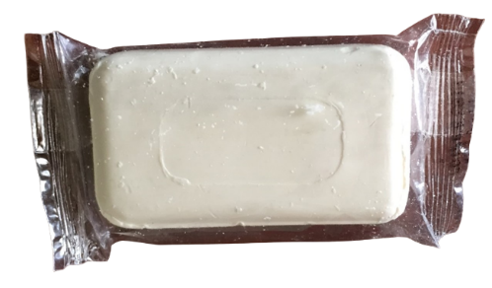
IFRC
Watsan Kit 2
400 units
BUCKET, plastic, 14L with clip cover and 50mm outlet
400 units
JERRYCAN, collapsible, 10L, food grade LDPE, screw cap
400 units
JERRYCAN, collapsible, 10L, food grade LDPE, screw cap
400 units
SOAP, body soap, 100g, piece Exp - 2027
2 units
PLASTIC SHEETING, woven, 4x60m, white/white, roll
1 unit
HYGIENE PROMOTION BOX A, promotion items

Slide 3
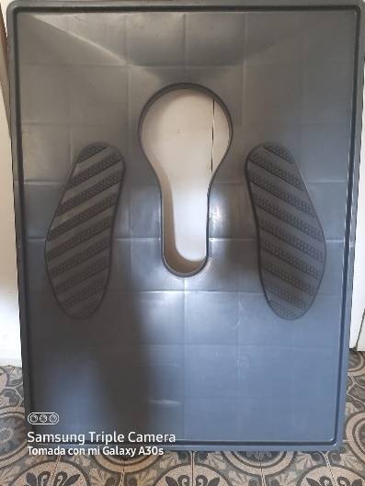
IFRC
Watsan Kit 2
4 boxes of 16.000 units
CHLORINE,40mg (NaDCC 67mg),for 10L water,1 tablet,DGR if>5KG – Exp 2025
209 boxes of 240 sachets
WATER PURIFICATION AGENT, for 10L
Exp – Dic 2023
2 units
POOL TESTER + accessories
500 Tablets
(pool test) TABLET DPD1 for dosing free chlorine
500 Tablats
(pool test) TABLET DPD3 for dosing total chlorine
20 units
SQUATTING PLATES, polypropylene,
100cm x 65cm x 100cm

