Slide 1
KITS DE HIGIENE para 5 Familias:
KITS DE HIGIENE
5 | Bucket,HDPE,with lid,14 litre
60 | Soap,toilet,bar,approx.125g,wrapped
5 | Torch, handheld, self- powered
5 | Child potty
10 | Multipurpose Cloth, cotton, 1,20x1.20m
10 | Sanitary pads,female,w/wings,disposables
5 | Whistle, for safety use, metal
5 | Underwear,female panties,qty ( 1 S, 3 M, 3 L, 2 XL )
5 | Laundry detergent, 1.kg + 600g
5 | Flyer 1p guide WASH&DignityKit,firstResp

Slide 2
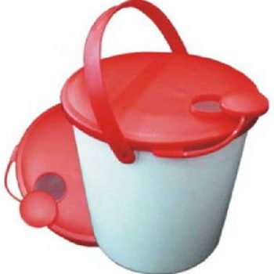
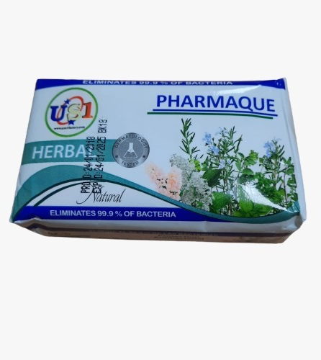
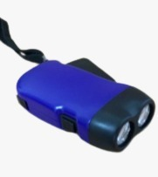
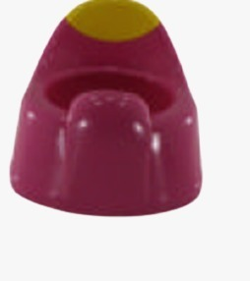
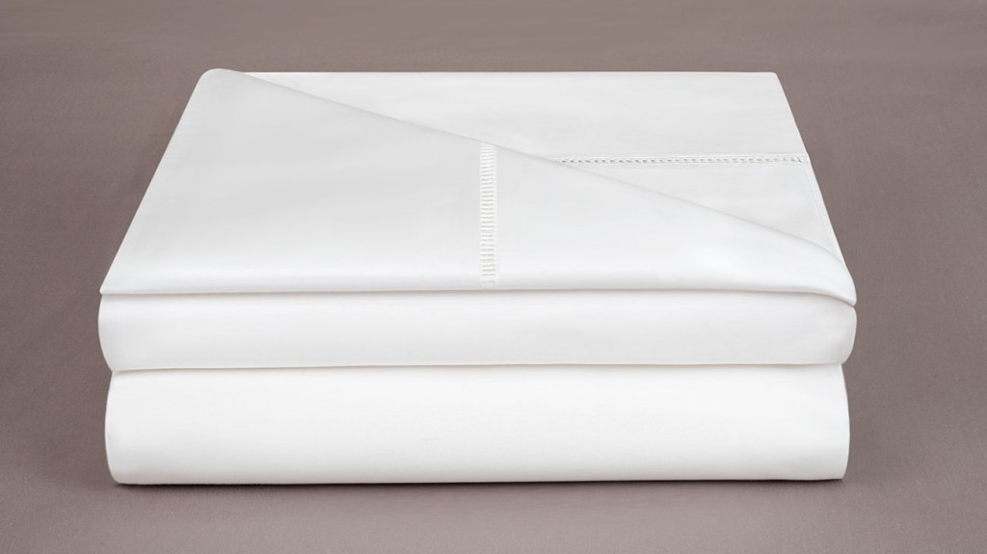
KIT DE HIGIENE
5 Unidad
Bucket,HDPE,with lid,14 litre Con y Sin grifo
60 unidades Soap,toilet,bar,approx.125g,wrapped
5 Unidades
Torch, handheld, self- powered
10 Unidades
Multipurpose Cloth, cotton, 1,50x1.00m
5 Unidades
Child potty

Slide 3
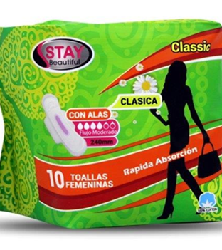
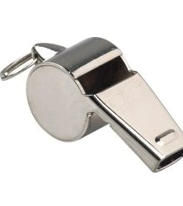
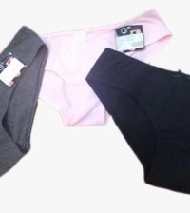
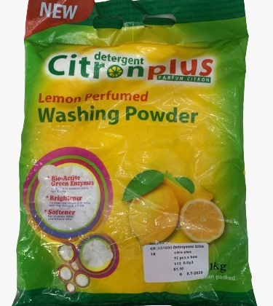
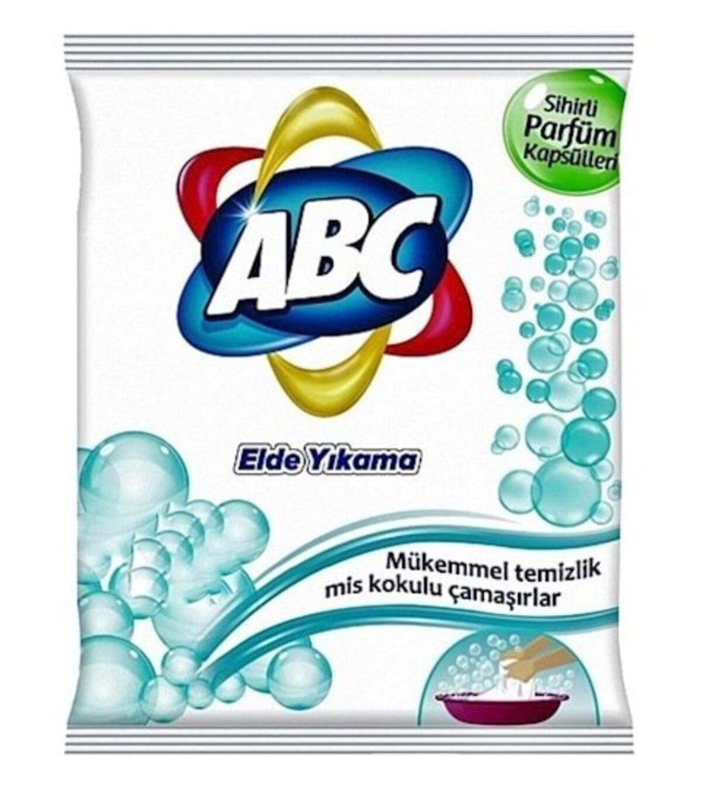
KIT DE HIGIENE
10 paquetes
Sanitary pads,female,w/wings,disposables
5 Unidades
Whistle, for safety use, metal
5 x
1 talla S
3 talla M
3 talla L
2 talla XL
Underwear,female panties
5 unidades
Laundry detergent, 1.kg + 600g
5 x Flyer 1p guide WAH&Dignity Kit, First Response

